Slide 1
Environmental Cleaning Tool Kit
Cleaning in Preoperative and Postoperative Areas
Module 2
Funded through the AORN Foundation and supported by a grant from Ecolab

Slide 2
Objectives
Upon completion of this module, participants will be able to:
describe appropriate cleaning methods;
list high-touch objects in the preoperative and postoperative environment;
discuss how often cleaning should occur, and;
describe the difference between turnover clean and terminal clean.

Slide 3
Definitions
Clean
the absence of visible dust, soil, debris, blood, or other potentially infectious material
Disinfection
a process that kills most forms of microorganisms on inanimate surfaces
Terminal cleaning
thorough environmental cleaning that is performed at the end of each day when the area is being used
Turnover clean
cleaning and disinfecting done to a room between patients throughout the day

Slide 4
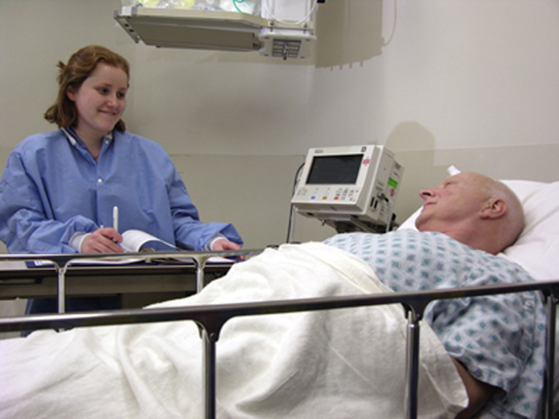
Terminal Cleaning
Terminal cleaning and disinfection should be performed daily when the area is used

Slide 5
Equipment and Supplies
Gather the correct equipment and supplies needed to clean and disinfect the room
detergents and disinfectants
low-linting cloths
mop
single-use disposable wipes
Check the expiration dates on detergents and disinfectants
if expired, discard the old product and replace it with new supply
Notes:
Discuss checking the Safety Data Sheets (formally known as “MSDS”) for instructions on how to properly discard the old, expired product. If possible, show team members the SDS sheets for the products they will use to clean at this time and talk through the process according to the manufacturer's guidelines.

Slide 6
Cleaning Cart
Carts are frequently used in terminal cleaning
to organize supplies
to bring cleaning equipment to and from patient care rooms
Notes:
Share with team members if your facility utilizes cleaning carts now. If there is a uniform way items are distributed in these carts, please share with the team the preferred stocking system.

Slide 7
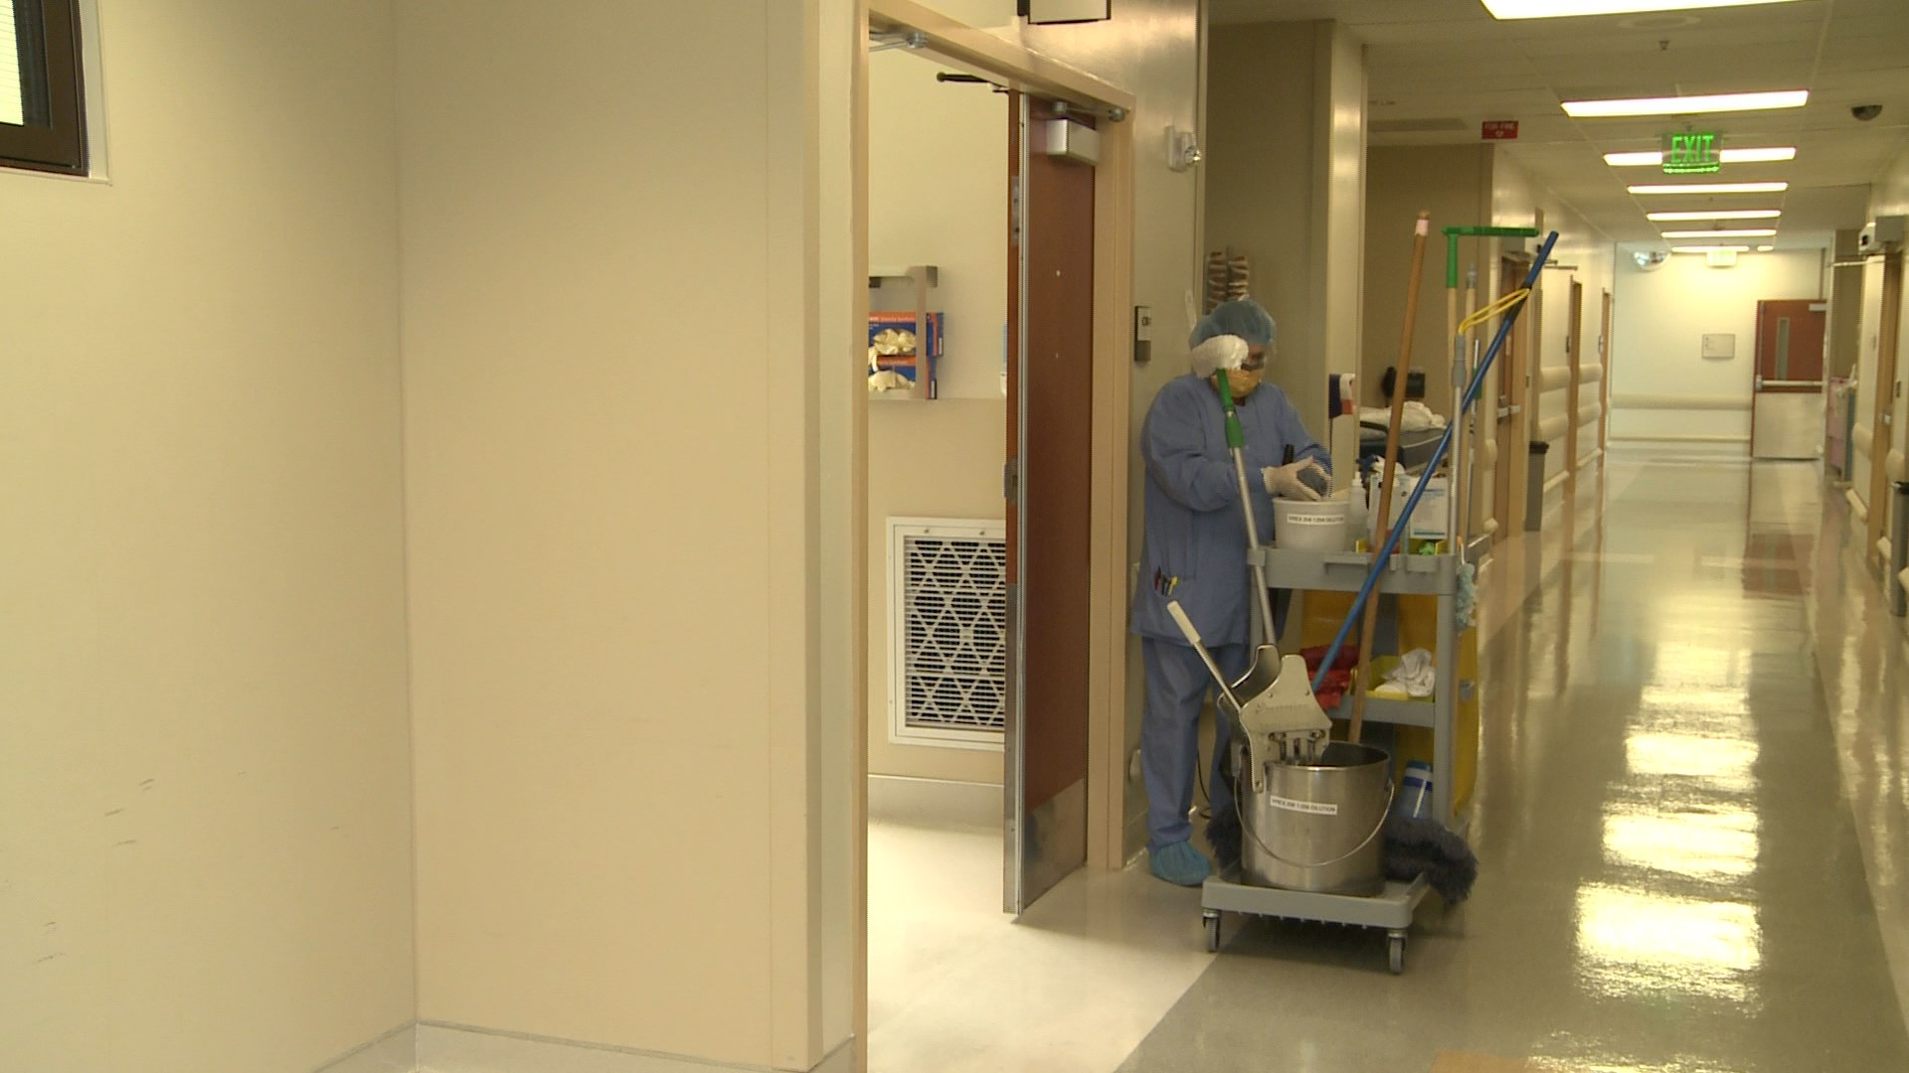

Slide 8
“Courtesy of Ecolab® Inc.”

Slide 9
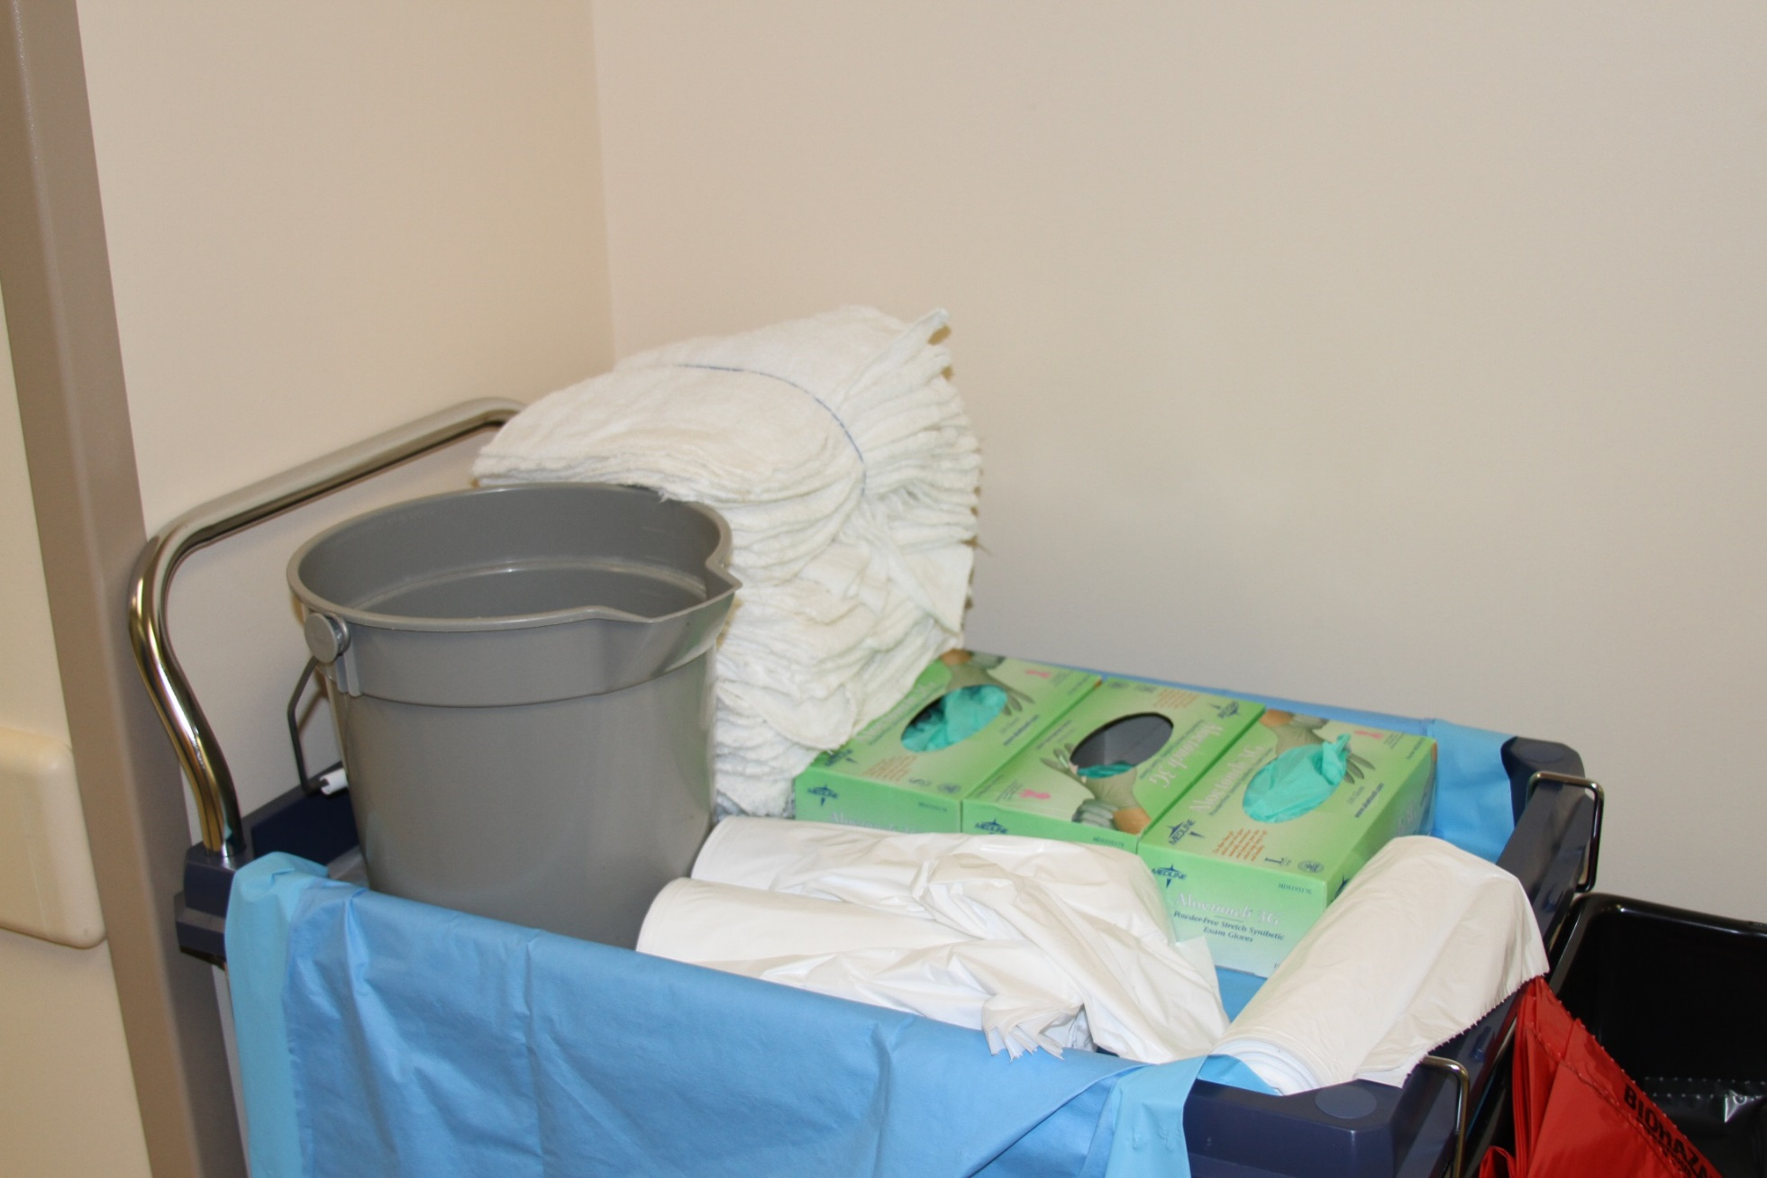

Slide 10
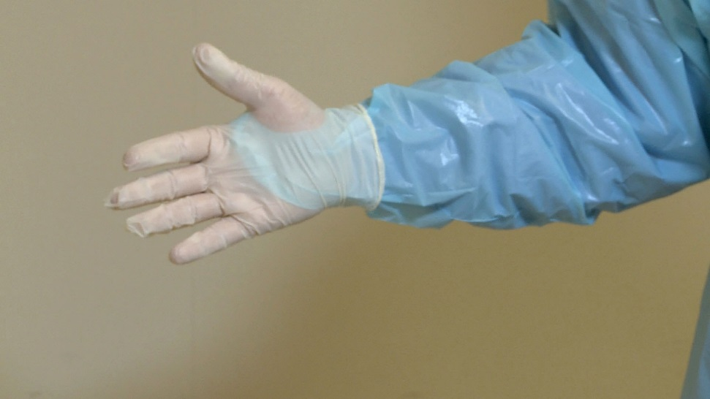
Standard Precautions
Always make sure to put on your personal protective equipment (PPE) before entering preoperative and postoperative rooms to clean
Notes:
Discuss why it is important to wear the protective equipment when cleaning pre/postoperative rooms. Refer to OSHA bloodborne pathogen guideline, if needed.

Slide 11
What must be cleaned?
Mobile and fixed equipment
imaging viewers
patient warming equipment
medical gas regulators
radiology equipment
suction regulators
Notes:
Talk about the items shown here and explain why cleaning and disinfecting of each piece of equipment is important for stopping the spread of infections.

Slide 12
What must be cleaned?
Chairs and stools
Furniture
Storage cabinets
Supply carts
Trash and linen receptacles
Notes:
Talk about the items shown here and explain why cleaning and disinfecting of each piece of equipment is important for stopping the spread of infections.

Slide 13
What must be cleaned?
Computers and accessories
Keyboard
Mouse
Touch screen
Door handles & push plates
Light switches
Telephones & mobile communication devices
Notes:
Talk about the items shown here and explain why cleaning and disinfecting of each piece of equipment is important for stopping the spread of infections.

Slide 14
What must be cleaned?
In the preoperative and postoperative care areas
call light
over-the-bed table
patient bed
patient monitor
television remote control
Notes:
Talk about the items shown here and explain why cleaning and disinfecting of each piece of equipment is important for stopping the spread of infections.

Slide 16
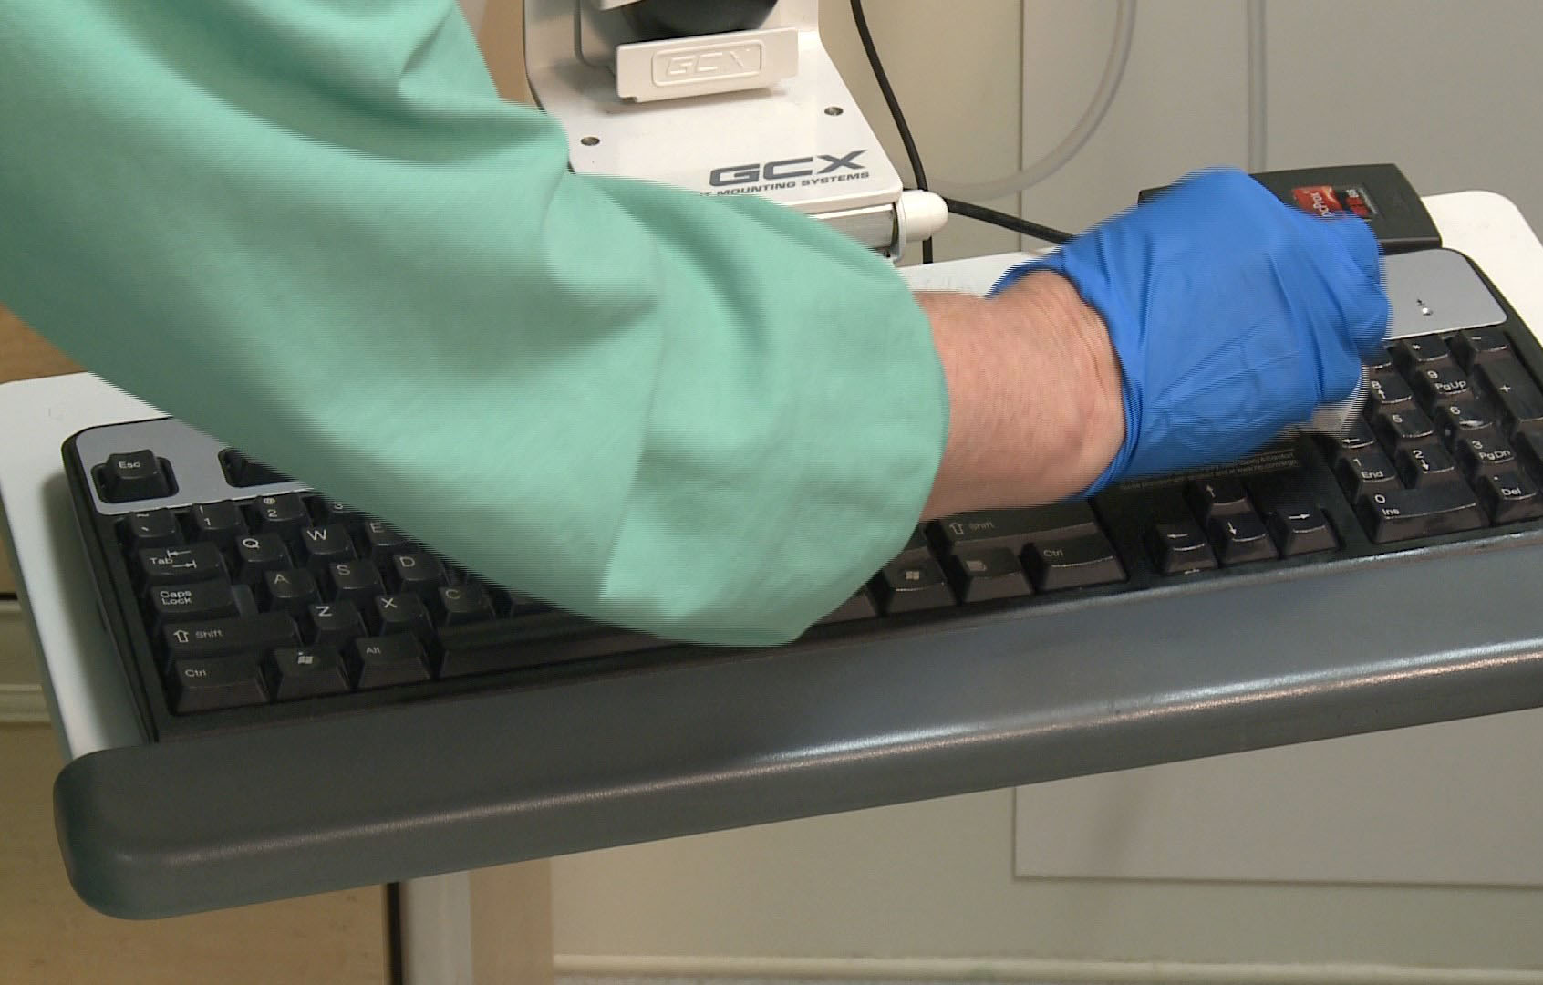

Slide 21
Terminal Cleaning in the Preoperative and Postoperative Care Area
Adapted with permission from Perioperative Standards and Recommended Practices.
Copyright © 2014, AORN, Inc, 2170 S. Parker Road, Suite 400, Denver, CO 80231. All rights reserved.
Notes:
Have team members identify items that are to be cleaned and talk through the process.

Slide 22
Cleaning Before Disinfecting
Cleaning of visible soil or dirt from objects is very important
soil and dirt can be a barrier stopping the disinfectant from working to kill germs on the surface
Notes:
Explain why blood, bodily fluids, or dirt can create a barrier to disinfecting environmental surfaces. If the disinfectant has to cut through additional barriers, it will not have the appropriate amount of time to be on the surface of the item and decreasing the amount of germs on that item.

Slide 23
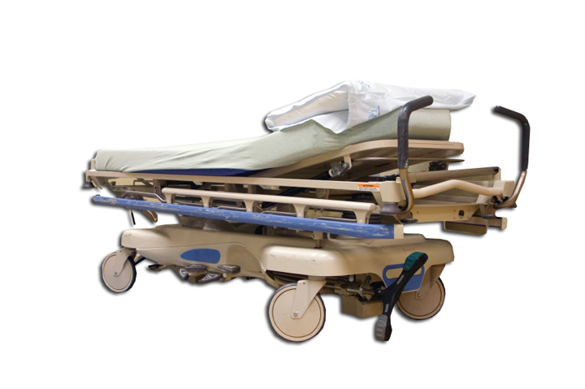
Terminal Cleaning
Clean and disinfect
all exposed surfaces
including wheels and casters
all equipment in the room
Move the equipment around the room to clean the floor underneath
Notes:
It is very important to move equipment and clean underneath. Dust can collect under equipment. Blood and bodily fluid may have been splattered underneath equipment that was not noticed during the day. Soil, dirt, and debris must be removed to provide a clean, safe environment for the patient.
Team members can choose to leave moved equipment in a slightly different location after cleaning has been performed. This is sometimes used to give a visual cue to the pre/postoperative team that the room has been terminally cleaned.

Slide 24
Detergent or Disinfectant?
Use a detergent before using a disinfectant to make sure all soil and dirt are removed if equipment is visibly dirty
Products are
one step: combined detergent and disinfectant
two step: two separate products for detergent and disinfectant
Notes:
Talk about the products used in your facility. Point out to personnel if the product is a one or two step product. Team members need to be able to verbalize the difference between the two types of products.

Slide 25
What should be cleaned first?
Clean from
1. top to bottom
2. clean to dirty areas
Clockwise or counter-clockwise cleaning may be performed when used along with clean-to-dirty and top-to-bottom cleaning methods
Notes:
Dust, debris, and contaminated cleaning solutions may contaminate items below if cleaning is not performed from top-to-bottom. The reason to clean from clean-to-dirty is to avoid potentially spreading germs from dirty areas into cleaner areas. Depending on the space, a clockwise or counter-clockwise may be used, but it should never replace the foundational methods of top-to-bottom or clean-to-dirty.

Slide 26
Turnover Cleaning in the Preoperative and Postoperative Patient Care Area
Adapted with permission from Perioperative Standards and Recommended Practices.
Copyright © 2014, AORN, Inc, 2170 S. Parker Road, Suite 400, Denver, CO 80231. All rights reserved.
Notes:
Discuss this slide with personnel. Have them point out objects in the picture and identify the frequency of cleaning during turnover cleaning. Make this interactive so personnel can really understand the purpose behind the recommended practices.

Slide 27
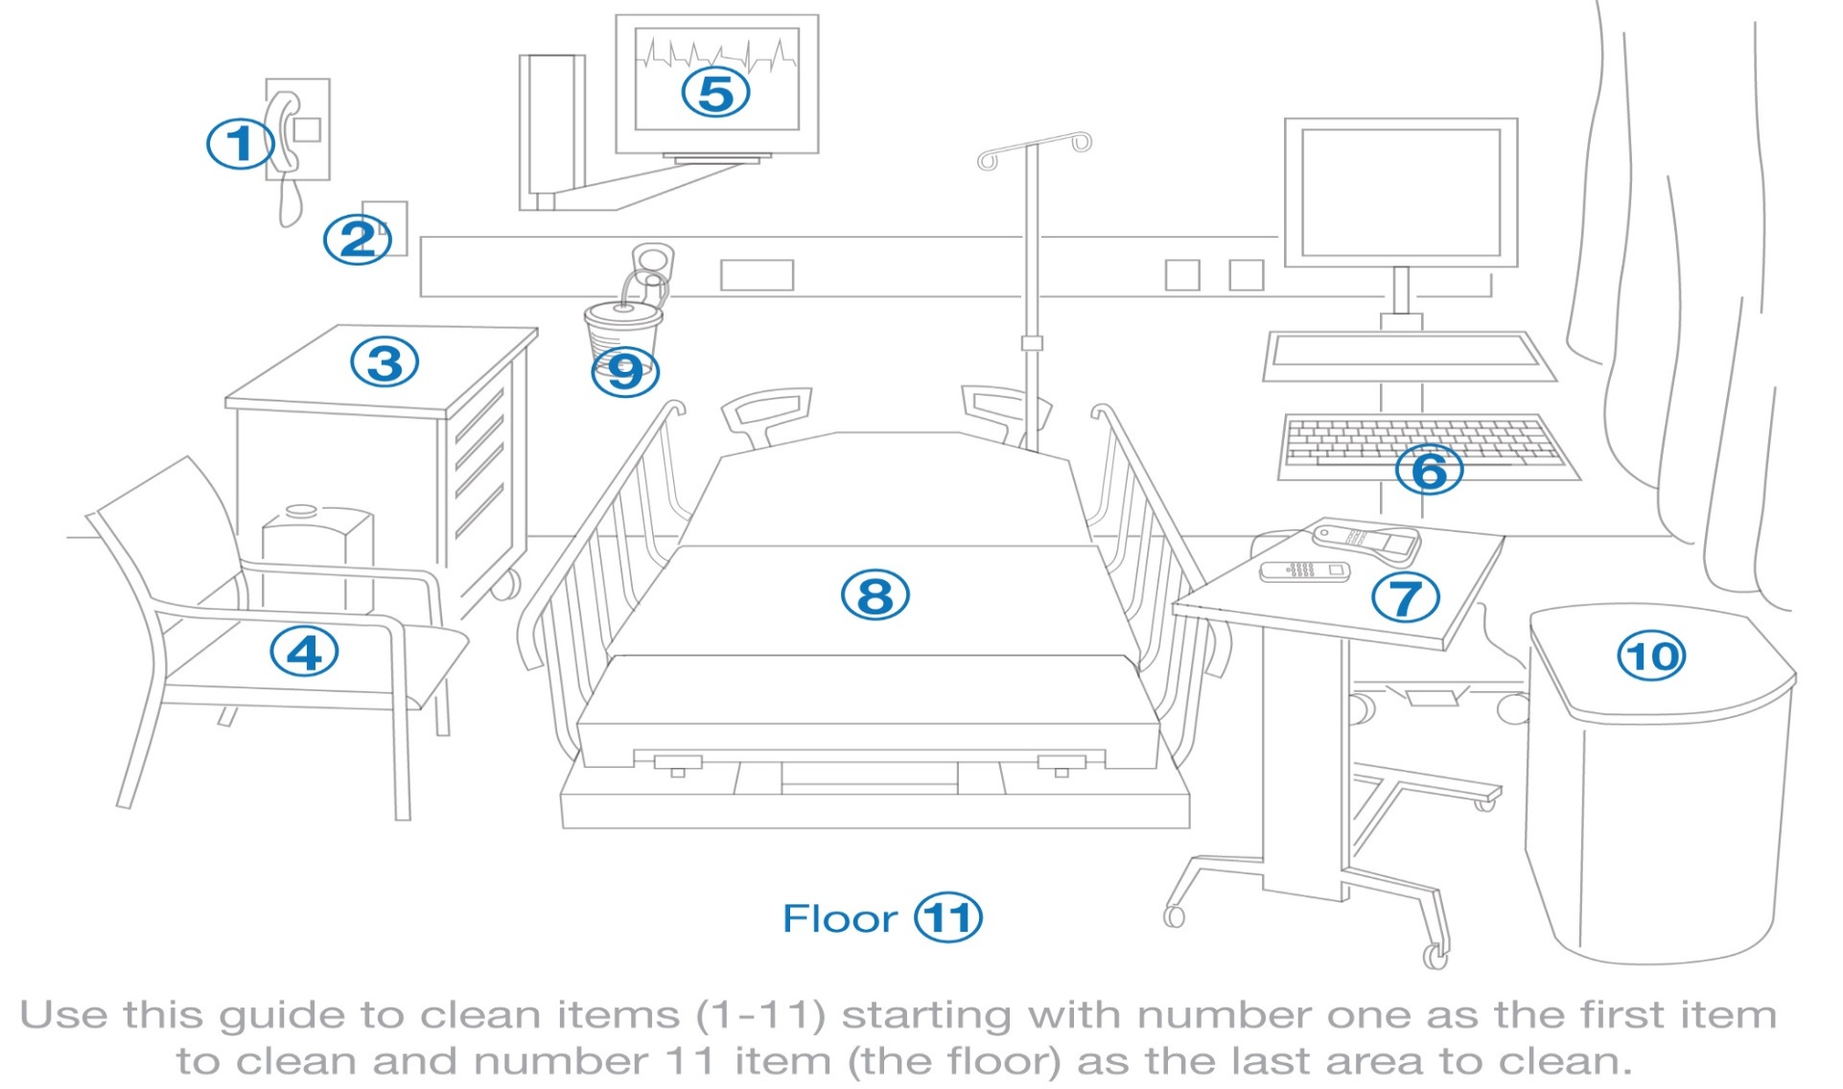
Cleaning
Notes:
Discuss this slide with personnel. Have them explain what this means. Make this interactive so personnel can really understand the purpose behind the recommended cleaning practices.

Slide 28
Floor Cleaning
Clean and disinfect the floor surfaces
at the edge of the room first
moving toward the center of the room
The center of the room is where most patient care happens, so the center is likely to be dirtier
Notes:
Have personnel explain why this is important using the clean-to-dirty cleaning method.

Slide 29
Turnover Cleaning
Cleaning and disinfecting the preoperative/ postoperative room between patients throughout the day
This step is very important!
stopping the spread of germs from one patient to the next
decreasing the amount of germs in the environment
Notes:
Remind personnel about the chain of infection discussed in Module One of this series. Every patient deserves care in a clean, safe environment. Having a clean, disinfected room for care to be delivered is a foundation of patient safety.

Slide 30
Turnover Cleaning
Do not begin cleaning until the patient has left the area
Steps in turnover cleaning
wearing correct PPE upon entering room
cleaning of patient care items and equipment
removing trash and linen bags from the room
Notes:
Always wear appropriate PPE per OSHA Blood borne pathogen standards. Have team members state the steps in cleaning (top-to-bottom, clean-to-dirty) since these rules apply to turnover cleaning just as they do in terminal cleaning. Removing the trash and linen bags at the end of the cleaning process ensures any cloths that were used in the cleaning process leave the room once team members are done cleaning. Every patient in the room, whether the first or the last, will be able to see the room is clean and tidy.

Slide 31
Cleaning the Patient Bed
Identify the process used at your facility for cleaning the patient bed
Inpatient verses outpatient
Be sure cleaning includes
handles
mattress
side rails
straps and attachments
Notes:
Many facilities have separate processes for cleaning beds based on if the patient is an inpatient or an outpatient. Some inpatient facility processes include bed cleaning by the team members once the patient bed is placed outside the OR door. The bed is moved, cleaned, and returned to be used again on a new patient. For outpatients, however, the bed is frequently left adjacent to the OR door so it can be used again by the same patient after the procedure is completed. In this scenario, the bed will be cleaned after the patient is discharged, normally in the postoperative patient room. Verify for team members what the process is at your facility and share with new team members now.

Slide 34
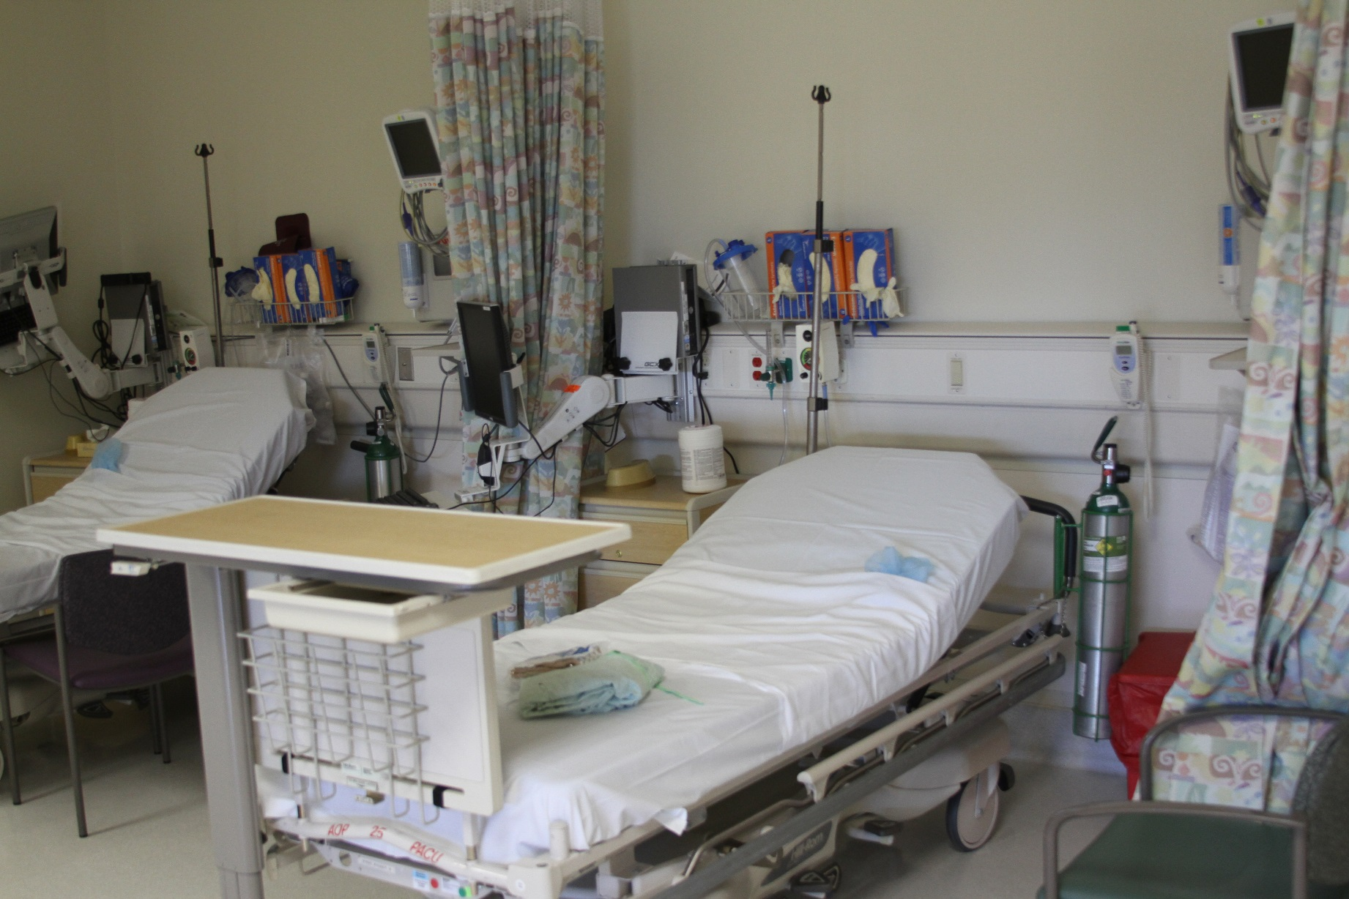

Slide 35
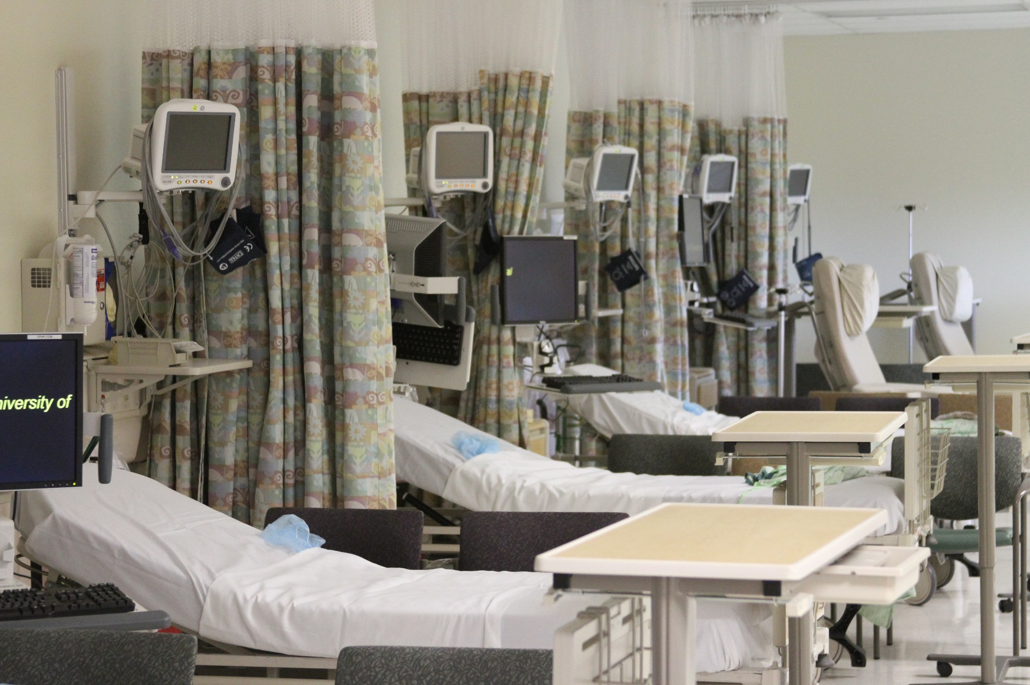

Slide 36
Additional Cleaning
Additional areas in the preoperative and postoperative area exist that are not cleaned daily
Each facility will decide how frequently these areas should be cleaned
weekly or monthly

Slide 37
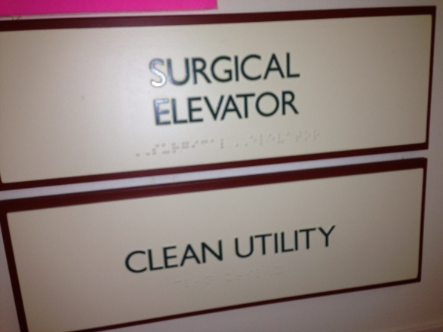
Additional Cleaning
These areas include
clean and soiled storage areas
closets
corridors
elevators
environmental service
handwashing sinks in corridors
shelves and storage bins
stairwells
Notes:
Talk about these areas with personnel and identify how often they are cleaned at this point in the presentation. If your facility uses a cleaning schedule or another tool for documentation of cleaning, share this with personnel as well. Ask personnel why they think it would be important to clean these spaces and discuss how cleaning these areas can stop the spread of infection.

Slide 38
Additional Cleaning
Offices
Personnel lounges
Pneumatic tubes and carriers
Privacy curtains
Waiting rooms
Walls and ceilings
Workstation desks
Notes:
Ask personnel why they think it would be important to clean these spaces and discuss how cleaning these areas can stop the spread of infection.

Slide 39
Coordinated Cleaning
Cleaning of the following equipment will need to be done along with facility maintenance
eyewash stations
ice machines
refrigerators
ventilation ducts
Routine maintenance of these items is necessary, but the equipment must be cleaned before bringing patients in for care
Notes:
Check with your facility’s maintenance department and validate how often these items are serviced for preventative maintenance. Eyewash stations may be checked by maintenance or nursing based on your facility policy, so discuss with team members who is responsible for this task and how frequently it is done. If your facility uses a cleaning schedule or another tool for documentation of cleaning, share this with personnel as well. If there are additional documentation requirements, such as with an eyewash station, show team members what documentation is required.
Ask personnel why they think it would be important to clean these spaces and discuss how cleaning these areas can stop the spread of infection. Every patient should feel like they are the first patient being cared for that day in the room. This is one way that we ensure safe, quality patient care.

Slide 40
Resources
Association for the Healthcare Environment of the American Hospital Association. Practice Guidance for Healthcare Environmental Cleaning. 2nd ed. Chicago, IL: American Hospital Association; 2012.
Guidelines for environmental infection control in health-care facilities. Centers for Disease Control and Prevention. http://www.cdc.gov/hicpac/pdf/guidelines/eic_in_hcf_03.pdf. Accessed February 7, 2014.
Recommended practices for environmental cleaning. In: Perioperative Standards and Recommended Practices. Denver, CO: AORN, Inc; 2014:255-276.
Notes:
Please use the above resources for additional guidance, if needed.

