Slide 1

Safe Patient Handling:
Recommended Best Practices
Presented By The University of Texas-School of Public Health
This material was produced under grant number SH-22316-SH-1 from the Occupational Safety and Health Administration, U.S. Department of Labor. It does not necessarily reflect the views or policies of the U.S. Department of Labor, nor does mention of trade names, commercial products, or organizations imply endorsement by the U.S. Government.

Slide 2
Learning Objectives
By the end of this module participants should be able to:
Describe the elements of OSHA and NIOSH’s Safe Patient Handling Programs.
Identify appropriate techniques and strategies for safe patient handling practices.
Describe how elements of this program can be incorporated into the participant’s inpatient nursing unit.

Slide 3
Background
Nurses and Nurses’ Aides are at high risk for work-related back pain
  Nurses’ aides at higher risk for work-related back pain compared to nurses
  Perform more lifting, bending and twisting in their jobs
Nurses, nurses’ aides and orderlies among those most likely to lose time from work due to work-related back pain
  Aides and orderlies have higher lost workday injury rates compared to nurses
References: Bureau Labor Statistics, 2005; Engkvist et al., 2000; Fuortes et al. 1994; Guo et al., 1995; Videman et al., 1984

Slide 4
Mechanics of Patient Handling Tasks
Patient transfers
  one-person (hug) vs. two-person (gait belt)
  bed-wheelchair, bed-commode, commode-chair
Repositioning
  one-person vs. two-person
  hook method, draw sheet, lift under thigh, and shoulder
None of the techniques assessed sufficiently protect patient handlers
All tasks exceed spinal load limits recommended by NIOSH (Marras et al. 1999)

Slide 5
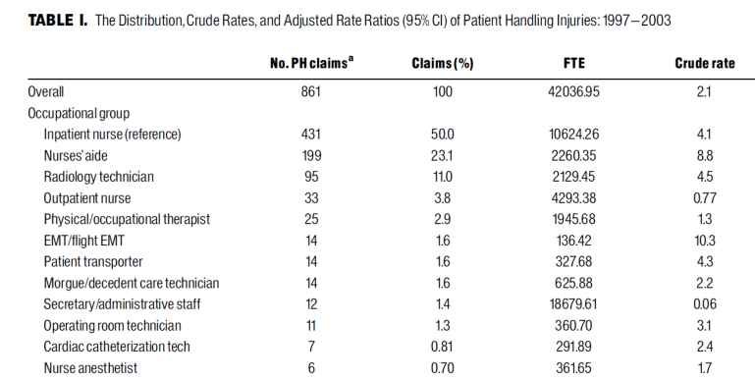
Study Findings
Pompeii et al.
Musculoskeletal Injuries Resulting From Patient Handling Tasks Among Hospital Workers. American Journal of Industrial Medicine

Slide 6
Injury Claims Resulting from Patient Handling
Nurses and Nurses’ Aides (n = 630)
1997-2003

Slide 7
What is “Best Practice” Patient Handling?
VA – Audrey Nelson
OSHA
NIOSH
AOHP
Washington State – OSHA
(copies are provided)

Slide 8
Elements of a ‘Best Practice’ Patient Handling Program –VA (1)
Ergonomic Assessment Protocol:
  Assess the hospital environment, examine injury rates, identify high-risk units
Patient Assessment Criteria
  Tools to help nurses evaluate patient characteristics that affect decision making about equipment and techniques for safe patient handling
Algorithms for Patient Handling/Movement
  Standardized processes for making decisions about the equipment and the number of staff necessary to perform high-risk activities safely.

Slide 9
Elements of a ‘Best Practice’ Patient Handling Program –VA (2)
Selection of patient handling equipment (mechanical, non-mechanical)
  Ensuring that the right equipment is available in sufficient quantities, kept in convenient locations, and in operating condition
BIRNs-Back Injury Resource Nurses
  Peers selected for high-risk nursing units who are specially trained in the identification of workplace hazards, in the criteria for assessing safe patient handling and movement, and in the use of algorithms. The role also includes onsite training and evaluation of peers regarding the proper use of equipment
“After Action Review”
  Knowledge the team has gained by performing a task in one setting and how it is applied in a different setting

Slide 10
Elements of a ‘Best Practice’ Patient Handling Program –VA (3)
“No-Lift Policy” or “Minimal Manual Lift Policy"
  Establishes an agreement among staff members that they will use the safest approach to handling and moving patients
  Indicates support from management that safe patient handling practices should be used

Slide 11
Patient Assessment Criteria
  Tools to help nurses evaluate patient characteristics that affect decision making about equipment and techniques for safe patient handling

Slide 12
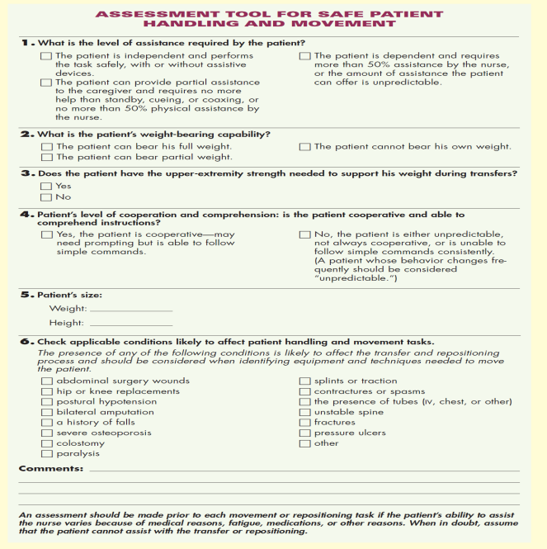

Slide 13
Algorithms for Patient Handling/Movement
  Standardized processes for making decisions about the equipment and the number of staff necessary to perform high-risk activities safely.

Slide 14
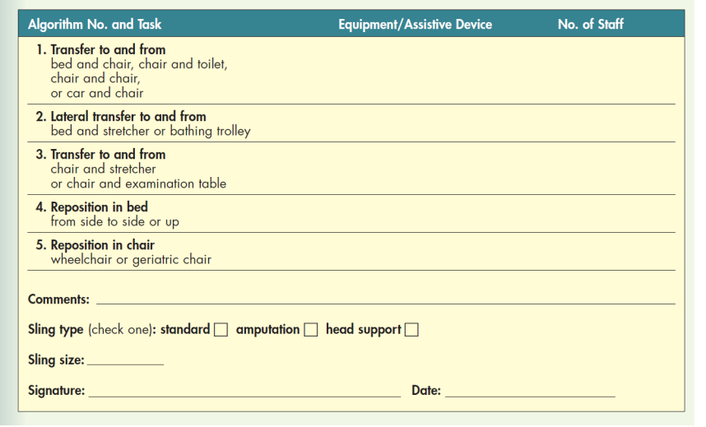

Slide 15
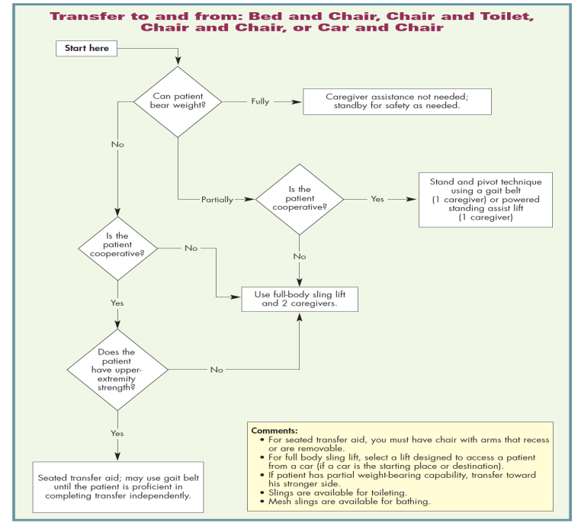

Slide 16
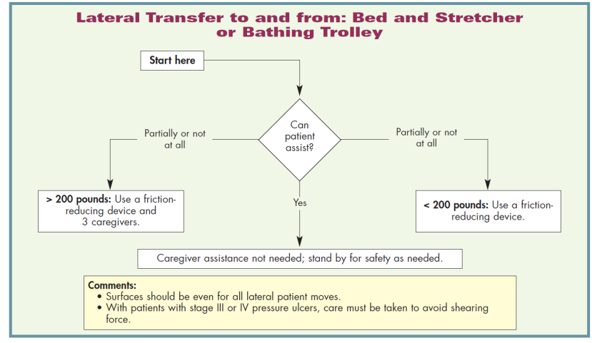

Slide 17
Selection of patient handling equipment (mechanical, non-mechanical)
  Ensuring that the right equipment is available in sufficient quantities, kept in convenient locations, and in operating condition

Slide 18
Equipment at St. Luke’s
Gait Belt
Draw Sheet
Hoyer Lift
Slide Board

Slide 19

Draw Sheet
http://www.youtube.com/watch?v=GABAUWN27Yg

Slide 20
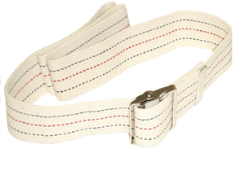
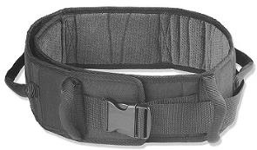
Gait Belts

Slide 21
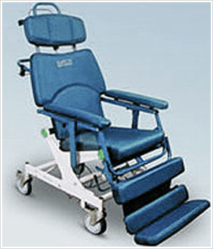
Barton Chair
http://www.youtube.com/watch?v=BQbCp_QSwio

Slide 22
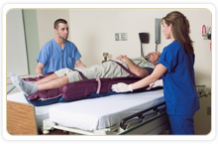
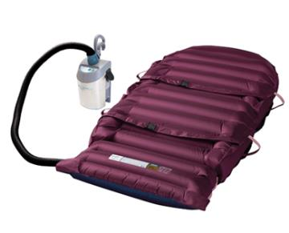
Hovertech: Hovermatt

Slide 23
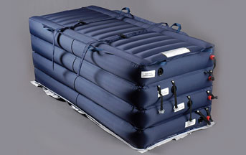
Hovertech: Hoverjack

Slide 24
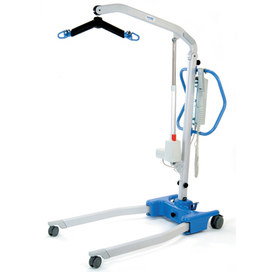
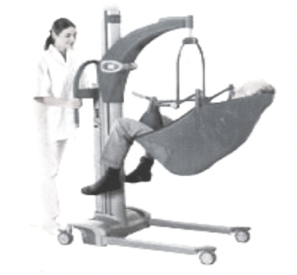
Hoyer Lift
http://www.youtube.com/watch?v=DinUBHOBlWU

Slide 25
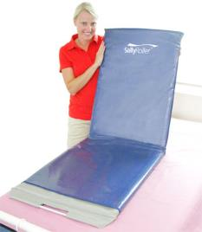
Slippery Sally Roller Slide Board
Sally Roller Slide Board
http://www.youtube.com/watch?v=QS-qjcgkk6E
http://www.slipperysally.com.au/sallyroller

Slide 26
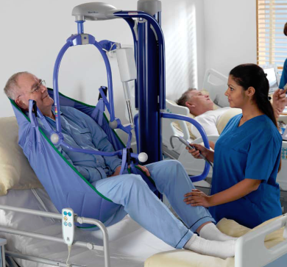
ARJO: Maxi Move (1)

Slide 27
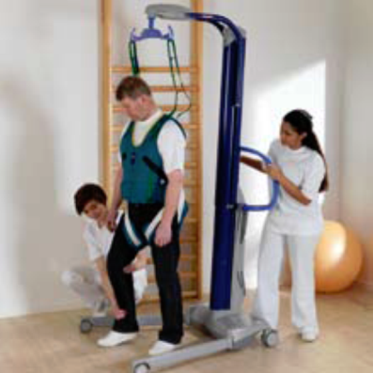
ARJO: Maxi Move (2)

Slide 28
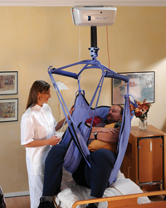
Overhead/Ceiling Lift
ARJO Maxi Sky-
Available in Various Weight Requirements

Slide 29
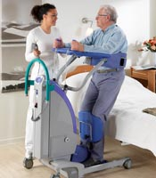
ARJO: Sara 3000 (Sit to Stand)
http://www.youtube.com/watch?v=XJu8p4r13WU

Slide 30
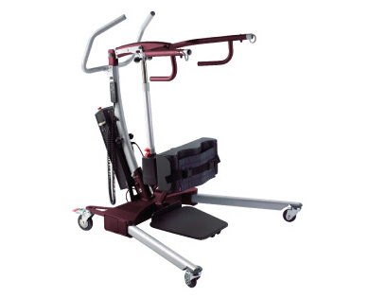
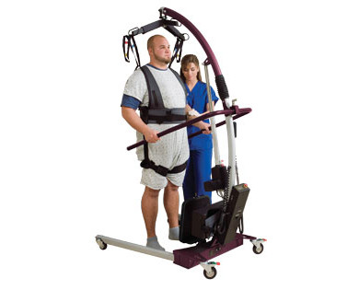
Hovertech: Sit to Stand

Slide 31
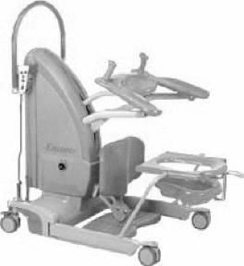
ARJO: Sara Plus

Slide 32
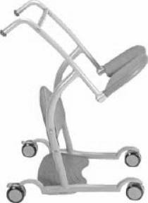
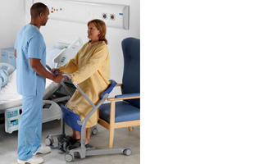
ARJO: SARA STEDY
Transfer aid

Slide 33
Plastic Liner/Slip Resistant Sheet
http://www.youtube.com/watch?v=RH-gsrUwLrA

Slide 34
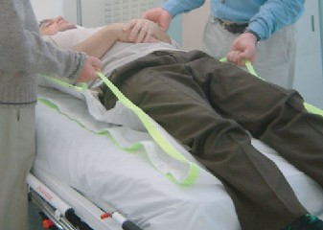
Draw Sheet with Handles

Slide 35
Elements of a ‘Best Practice’ Patient Handling Program –VA
BIRNs-Back Injury Resource Nurses
  Peers selected for high-risk nursing units who are specially trained in the identification of workplace hazards, in the criteria for assessing safe patient handling and movement, and in the use of algorithms. The role also includes onsite training and evaluation of peers regarding the proper use of equipment
“After Action Review”
  Knowledge the team has gained by performing a task in one setting and how it is applied in a different setting

Slide 36
Research: Evaluation of “Best Practice” Program Elements
Evidence Tables
  Biomechanical Studies
  Primary Evaluation of Multifaceted Programs that include patient handling equipment
  Systematic Reviews

Slide 37
Primary Evaluation Studies (1)
13 Studies Examined Multiple “Best Practice” Program Elements
  Overhead Lifts in long-term care facilities were most effective at reducing the risk of injury.
  The combination of mechanical lift equipment and training was most effective at reducing injuries and lost workdays in the hospital setting.
  Refresher training improves/sustains adoption of safe patient handling practices.
  Some studies found the use of algorithms to guide staff in deciding which transferring and/or lifting method (equipment) to use were effective.

Slide 38
Primary Evaluation Studies (2)
  Lift Teams were not effective as the only method for addressing patient handling requirements, nursing staff did not want to wait for a Lift Team member to show up to do the task.

Slide 39
Adoption of Safe Patient Handling Practices:
What Research Tells Us
Prior studies have reported promising results of reduction of patient handling injuries when patient handling equipment was used (Owen et al., 2002; Evanoff et al., 2003; Engvist et al., 2000; Byrnes et al., 2004).
Regardless of outcome, all of these studies reported that barriers in the work process hindered adoption of patient handling equipment use.

Slide 40
Barriers to Equipment Use and Other Best Practices
Lack of knowledge on how to use equipment
Infrequent training
Poor accessibility of equipment
Lack of perceived need
Lack of time to use equipment
Lack of staff to assist with patient moves/transfers
Lack of motivation on the part of staff
Lack of policy (no lift/minimal lift)
Rapid changing patient population disrupts implementation of intervention programs
Patients may act negatively to towards it

Slide 41
Promoters to Equipment Use and Other Best Practices
Management involvement and support
Combination of equipment, training and procedures to assess patient mobility needs
Good communication with staff about the patient handling program
Unit champions (sometimes this includes nurses who have been previously injured)
Assessment of equipment that fits the patient handling needs of the patient population.
Training, training, training!

Slide 42
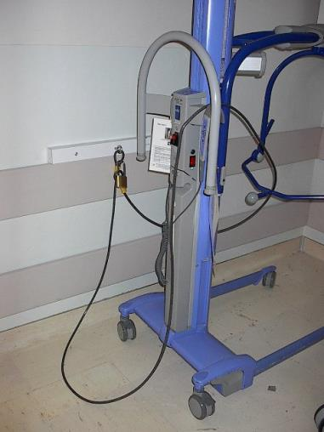
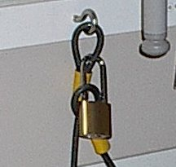
Unit-level implementation
Equipment and overhead supply cabinet (not shown) are locked to prevent items from disappearing.

Slide 43
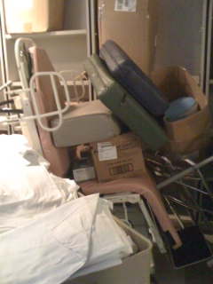
Equipment is Inaccessible

Slide 44
Nursing Culture
Patient handling is part of the job
Hands-on care is a valued part of the job
New nurses want to “fit in”
Social pressure to get job done quickly

Slide 45
“A Bad System Will Defeat A Good Person Every Time”
- W. Edwards Deming

Slide 46
Summary
One-Size Fits All is not a feasible approach to developing
a unit level Best Practice Patient Handling Program
This summary provides elements of proposed Best Practice only
It is best to pick elements of these proposed programs that best
Fit the patient handling needs of your patient population
Select elements that can be incorporated and tailored to fit your
unit

Slide 47

Thank You

